Slide 1
TravellingON
By Galadiola
Team members: Nataliia Slobodianiuk Tasks 1-5 & 7

Slide 2
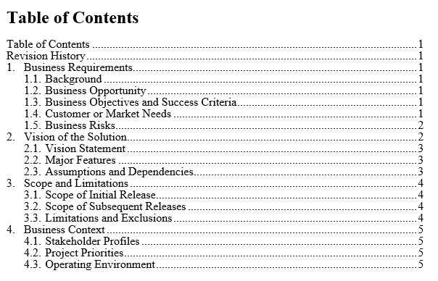
Vision and Scope Document

Slide 3
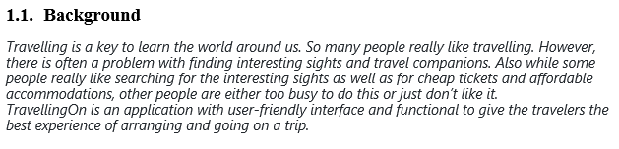
Vision and Scope Document

Slide 4
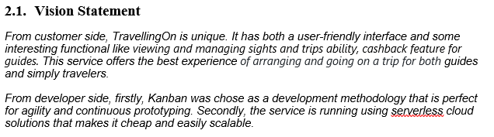
Vision and Scope Document

Slide 5
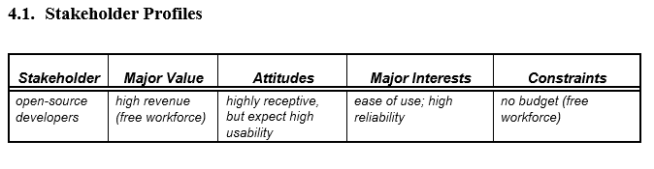
Vision and Scope Document

Slide 6
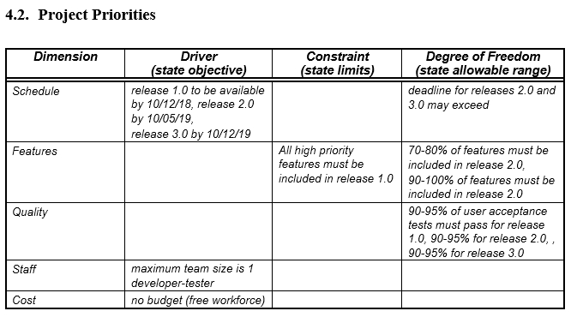
Vision and Scope Document

Slide 7
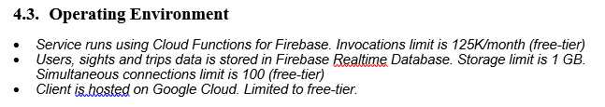
Vision and Scope Document

Slide 8
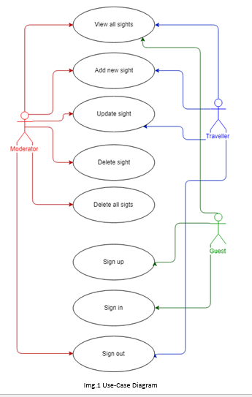
UserStories

Slide 9
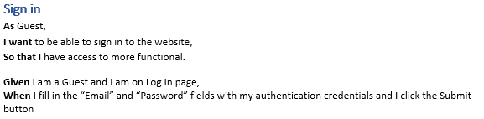
UserStories

Slide 10
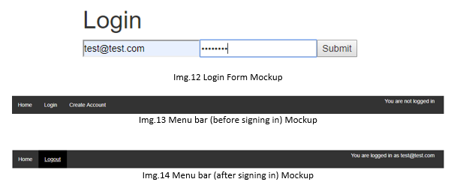
UserStories

Slide 11
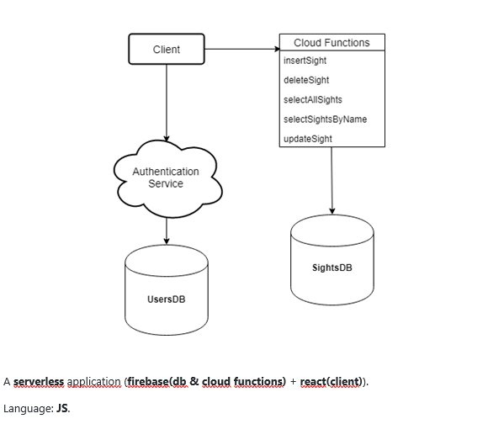
UML, Architecture

Slide 12
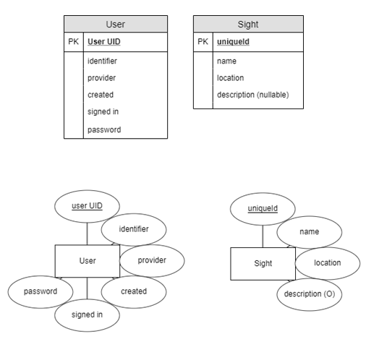
UML, Architecture

Slide 13
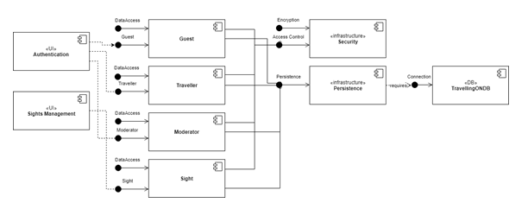
UML, Architecture

Slide 14
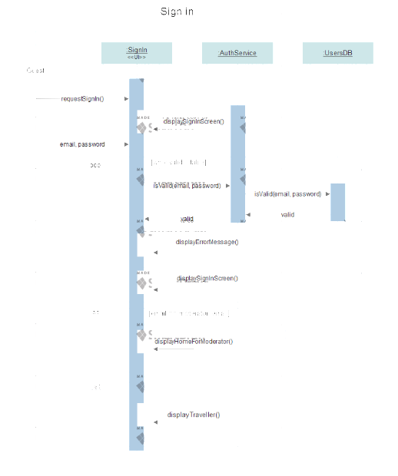
UML, Architecture

Slide 15
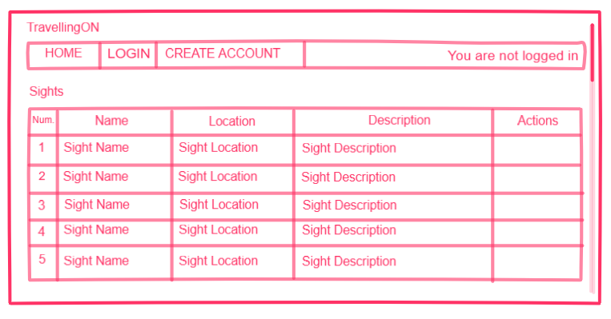
Design

Slide 16
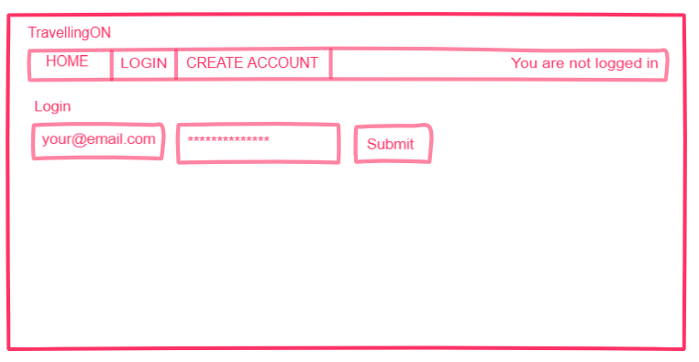
Design

Slide 17
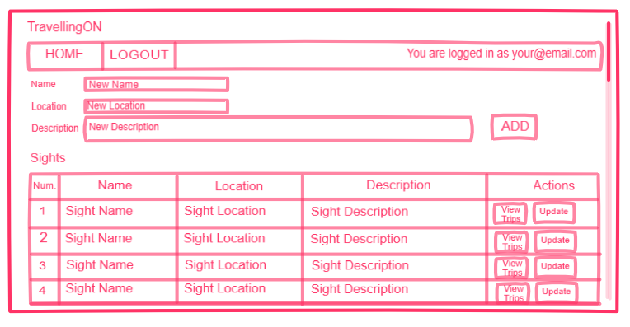
Design

Slide 18
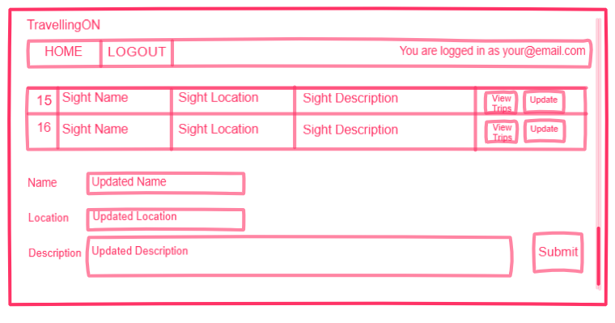
Design

Slide 19
Design
clickable prototype made with InVision (public share link: https://projects.invisionapp.com/share/EFRGGOO4TCZ)

Slide 20
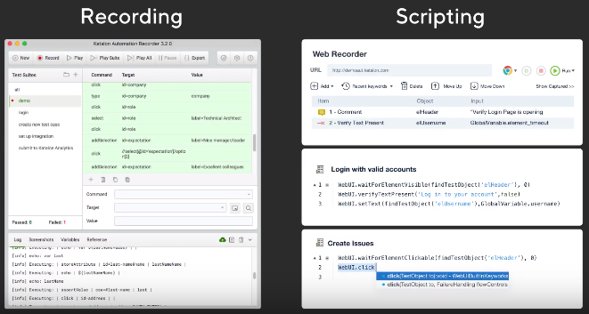

Automatic Tests
Katalon Studio

Slide 21
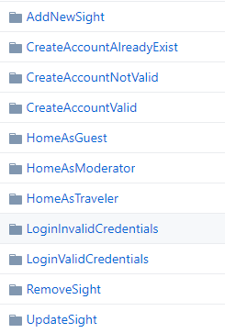
Automatic Tests

Slide 22
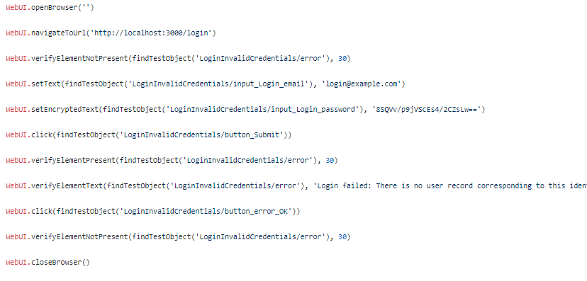
Automatic Tests

Slide 23
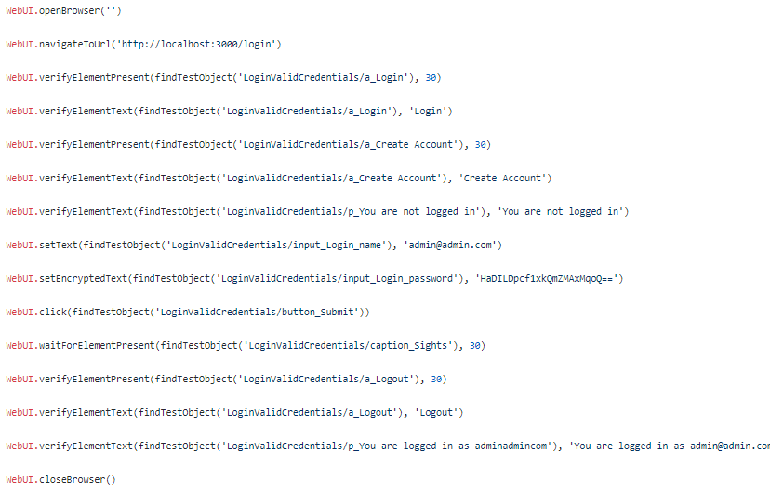
Automatic Tests

Slide 24
Manual Tests
Usability testing checklist for UI
Functional testing checklist
Compatibility testing checklist
Checklist for basic security testing

Slide 25
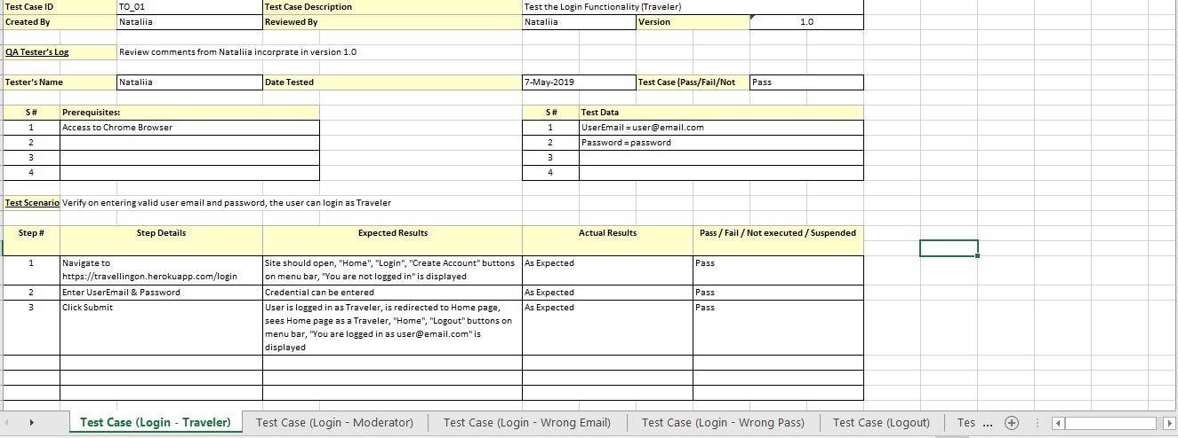
Manual Tests

Slide 26
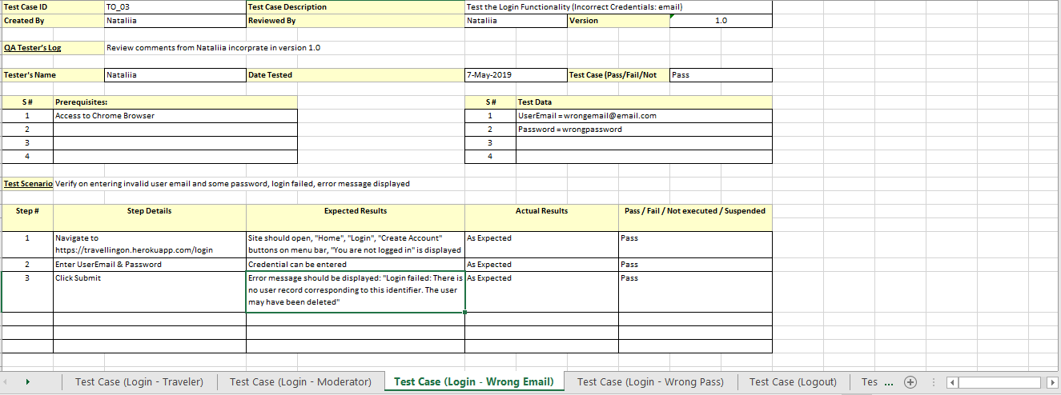
Manual Tests

Slide 27
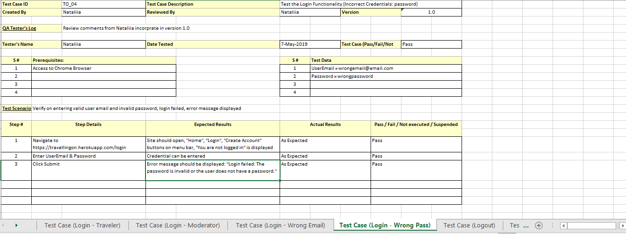
Manual Tests

Slide 28
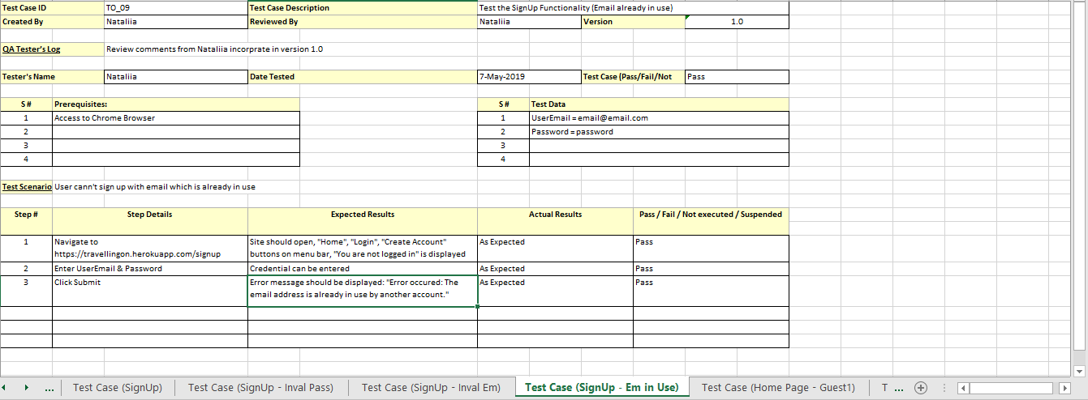
Manual Tests

Slide 29
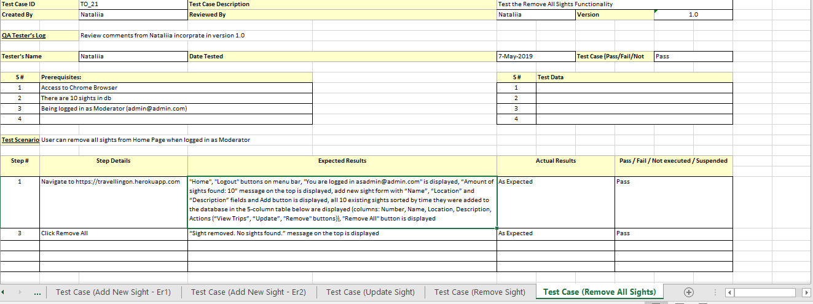
Manual Tests

Slide 30
Thank you for your attention!
Hope you haven’t gotten too bored :P

